Slide 1
MBA532 – AI in Business
MODULE 1 – AI Overview/Landscape

Slide 2
Size of AI Market and Growth Rate
Size of AI Market and Growth Rate

Slide 3
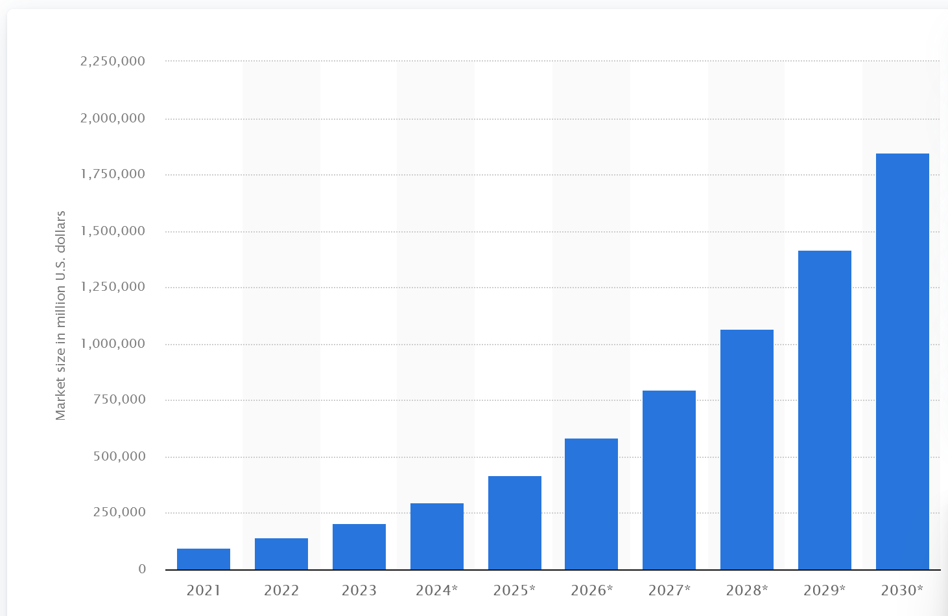
Artificial intelligence (AI) global market size worldwide in 2021 with a forecast for 2030 (in million U.S. dollars) – Source: Statista

Slide 4
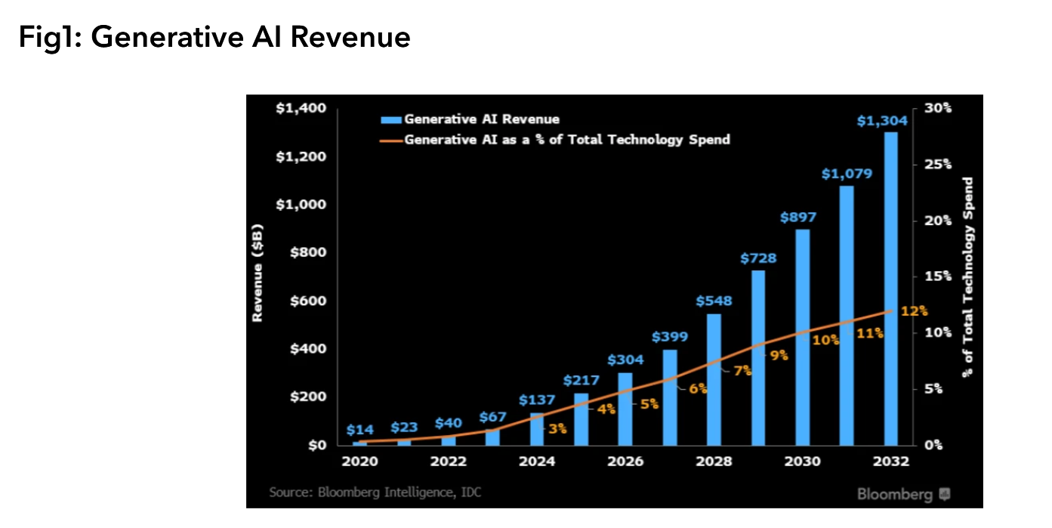
Generative AI market size will grow from $40 billion in 2022 to $1.3 trillion in 2032 (CAGR 42%): Source: Bloomberg

Slide 5
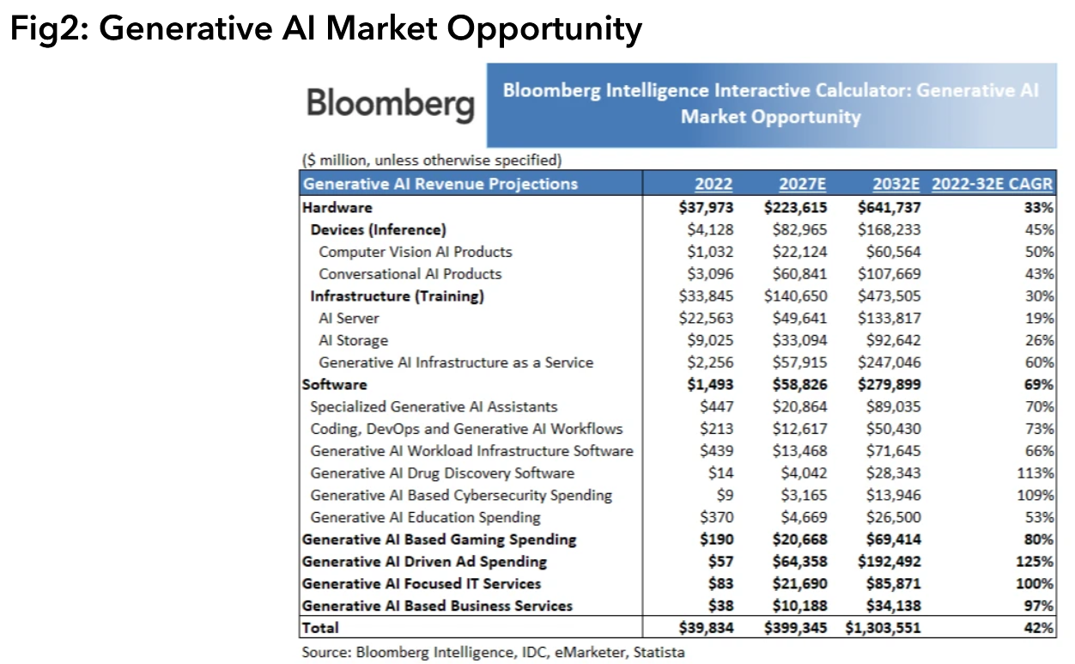
Breakdown - Generative AI Market Opportunity

Slide 6
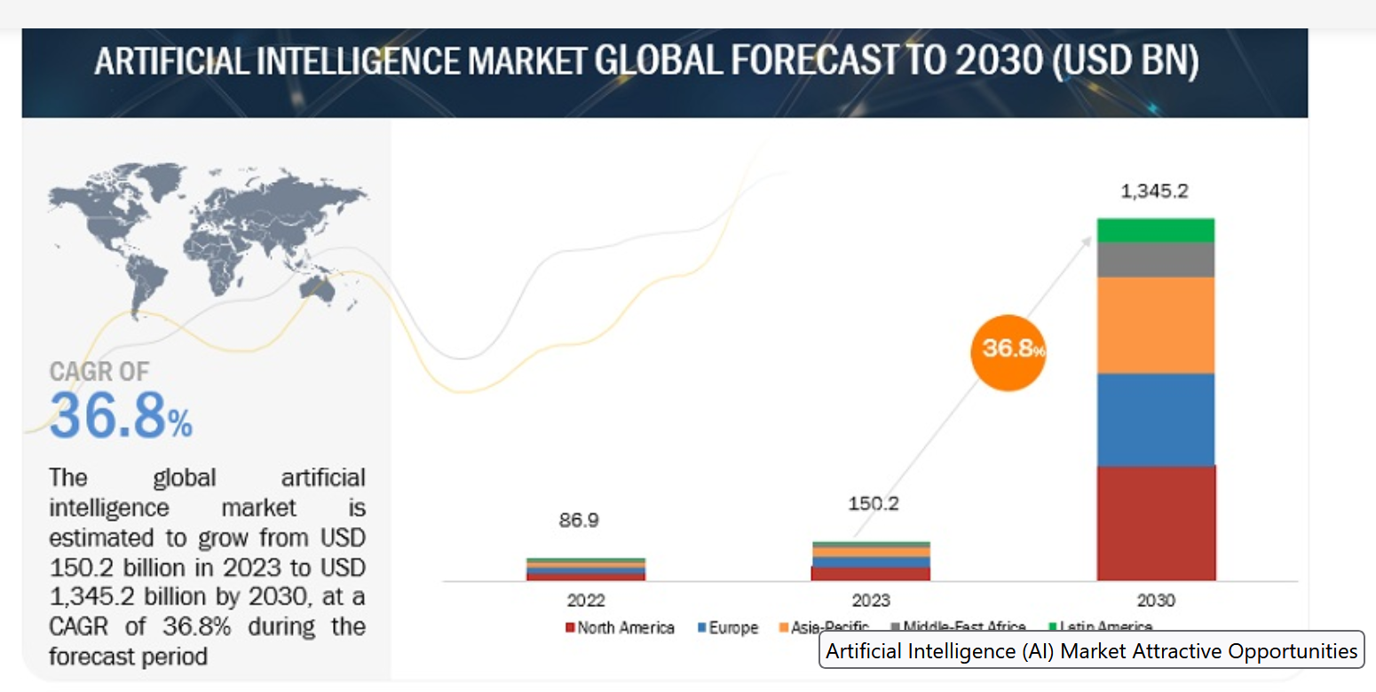
Artificial intelligence (AI) Global Market Size and Growth Forecast (2022-2030) – Source: Marketsandmarkets.com

Slide 7
Short term Generative AI substantive forecast – Source: Marketsandmarkets.com
Short-term implications of the AI Market Forecast (2023-2025)
Fine tuning and optimization of LLMs for various applications
Integrating text-based generative AI with other modalities, such as images and videos

Slide 8
Medium Term Generative AI substantive forecast – Source: Marketsandmarkets.com
Medium-term implications of the AI Market Forecast (2026-2028)
Generative AI models become more domain specialized, with RAG.
Users acquire fine-grained control over style, tone.
Generative AI models seamlessly integrate with existing software and platforms used across industry verticals
These developments increase Generative AI’s capability to adapt to industry-specific needs, and to a diverse LLM market

Slide 9
Evaluating Where AI stands now on multiple dimensions
Where does AI stand now from several viewpoints

Slide 10
Evaluate AI’s impact on business for each question, using the scale provided
Consider following scales, dimensions or spectrums and think about where AI may fall on each:
AI Outcome:
Injury ….. Survival ….. Growth
AI Types:
Narrow Intelligence ….. Broad AI ….. AGI
Magnitude of improvement in business outcomes:
No Change .. Linear .. Exponential
Ethical Impact of AI:
Negative … Neutral ... Positive
Who will eventually be in control because of AI?
Machines … Humans

Slide 11
Evaluate AI’s impact on business for each question, using the scale provided
Speed of progress on AI – should this be:
Frozen … Slow .. Rapid
Where is progress most noticeable?
Generative AI .. Responsible AI .. Explainable AI
Where can AI help humans the most?
Repetitive/boring tasks? Longevity? Dangerous tasks? Creative tasks?
What is the relationship of AI capabilities and Human capabilities:
No overlap … Overlaps … Augments
What is the likely trajectory of how humans will perceive AI in future:
Adversarial … Neutral … Friendly

Slide 12
Overall assessment
To paraphrase what I. J. Good wrote in 1965, if AI continues to maintain its rate of progress, it may represent the last major invention by Man. That is, all future discoveries could be AI or machined-based, as AI progress marches toward AGI.
Clearly, humans are just beginning to understand of the scale of changes to come as a result of AI.

